Slide 1
Systems Analysis and Design 10th Edition
ToolKit D– The Systems Analyst’s Toolkit – Internet Resource Tools

Slide 2
Chapter Objectives
Describe the characteristics of the Internet and the World Wide Web
Plan an Internet search strategy, review your information requirements, use the proper search tools and techniques, evaluate the results, and consider copyright and data integrity issues
Use search engines, subject directories, and the invisible Web to locate the information you require

Slide 3
Chapter Objectives
Demonstrate advanced search techniques, including Boolean logic and Venn diagrams
Describe Internet communication channels, including social networking, forums, newsletters, blogs, podcasts, RSS feeds, Webinars, mailing lists, Web-based discussion groups, chat rooms, instant messaging, and text messaging
Provide examples of IT community resources of value to a systems analyst
Explain the benefits and disadvantages of online learning opportunities

Slide 4
Overview
As a systems analyst, you rely on your knowledge, skills and experience
The Internet can assist you with technical problems and can help you advance your career by offering access to training, education, and communication with other IT professionals

Slide 5
Planning an Internet Research Strategy
You can use a four-step plan to navigate efficiently (avoiding frustration and wasting time) and confidently toward your objectives:
Step 1. Review your information requirements
Step 2. Use the proper search tools and techniques
Step 3. Evaluate the results
Step 4. Consider copyright and data integrity issues

Slide 6
Planning an Internet Research Strategy (Cont.)
Review Your Information Requirements
Make sure you really understand what you are seeking
Use the Proper Search Tools and Techniques
Decide on search engines, subject directories, commercial sites, IT publications, professional associations, forums, or other areas to explore

Slide 7
Planning an Internet Research Strategy (Cont.)
Evaluate the Results
Ask questions when accessing content
SOURCE - Is the author identifiable and is the author an expert on the subject?
ACCURACY - Does the information come from a commercial source that is offering its own solution
SCOPE - Is the information specific enough? If not, narrow and refine your search
CURRENCY - How old is the information? Is the topic static or dynamic?
LOOK AND FEEL - Is the information easy to access and navigate

Slide 8
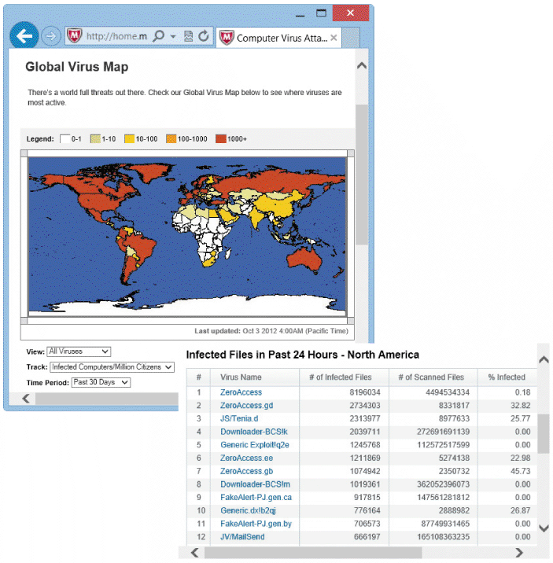
Planning an Internet Research Strategy (Cont.)
Consider Copyright and Data Integrity Issues
Ensure that you legally can use the material, and that the content is safe and free of threats
FIGURE TK D-2 McAfee’s site shows how many computers and files are infected at any given time

Slide 9
Search Basics
You must know how to use search engines, subject directories, and searchable databases called the invisible Web
Subject directory or topic directory is a Web site that allows you to find information by using a hierarchy, starting with a general heading and proceeding to more specific topics
The invisible Web, also called the deep Web or hidden Web, refers to a vast collection of documents, databases, and Web pages that are usually not detected by search engines, but can be accessed using other tools and techniques

Slide 10
Search Engines
A search engine often is the best starting point for gathering information
A well-planned search narrows the range of content to a manageable level
Allows you to explore the choices or execute a sub search within the focused results
It is important to understand the intended use and limitations of a search engine before applying it to a task

Slide 11
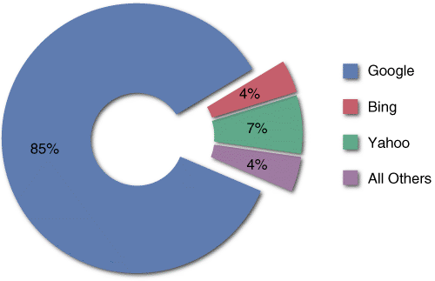
Search Engines (Cont.)
Search Engine Concepts
Search engines use a specialized computer program called a spider or crawler that travels from site to site indexing, or cataloging, the contents of the pages based on keywords
FIGURE TK D-3 The chart shows the dominant market share enjoyed by Google

Slide 12
Search Engines (Cont.)
INDEXED SEARCH ENGINES
Google, Yahoo!, and Bing are indexed search engines that organize and rank the results of a search
Each tool has its own search algorithms, features, and user interface
META-SEARCH ENGINES
Dogpile, which collects search results from Google, Yahoo!, Bing, and several others is very popular

Slide 13
Search Engines (Cont.)
Search Techniques
Refine your topic
Translate your question into an effective search query
Review the search results and evaluate the quality of the results
Organize the results of your search so you can recognize and revisit important sites

Slide 14
Search Engines (Cont.)
Online Tutorials
When you learn a skill, it usually helps to get some tips and pointers from an expert
Librarians can still offer valuable advice about Internet searching
Advanced Search Techniques
Option to search within returned results and the ability to search within specific areas, such as forums
One of the most powerful advanced feature is the option to use Boolean logic

Slide 15
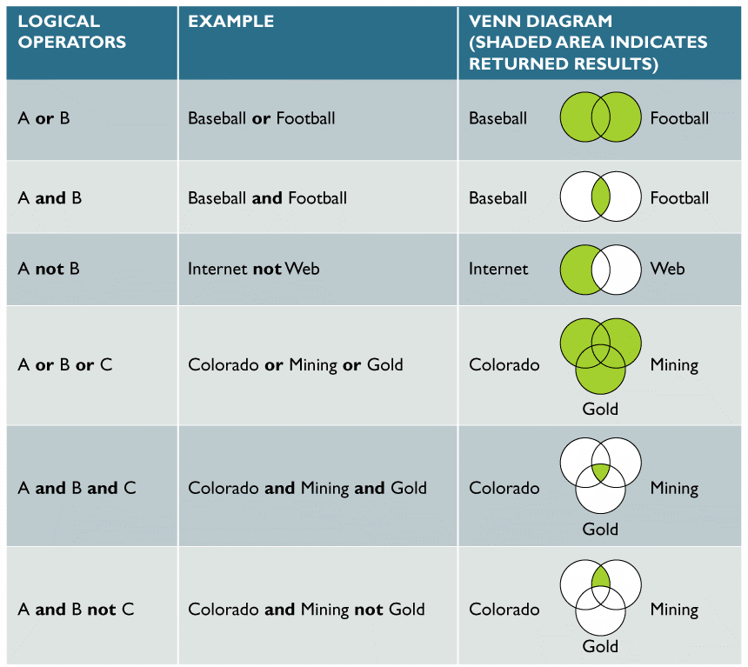
Search Engines (Cont.)
FIGURE TK D-5 Examples of logical operators OR, AND, and NOT. The shaded area represents the
returned results. OR is the most inclusive term, returning results if any of the terms appear; AND requires all
keywords to appear; and NOT excludes results even if they are found in the same document

Slide 16
Search Engines (Cont.)
OR
Retrieves all results containing either term
AND
Retrieves only those results in which all terms linked by the AND operator are present
NOT
Can be used to exclude certain records
USING PHRASES
More specific than an AND operator because it specifies an exact placement of terms
USING FILL-IN FORMS
Many users find it easier to fill in a form than to work with Boolean operators

Slide 17
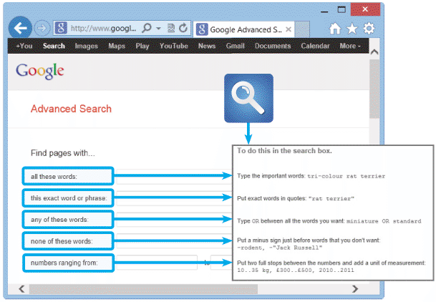
Search Engines (Cont.)
FIGURE TK D-6 These five examples show how to use Google’s fill-in form to perform an advanced search. On its site, Google offers many more advanced search samples and tips

Slide 18
Search Engines (Cont.)
Search Checklist
Does the topic have any unique words, phrases, or acronyms?
Do any of the search terms have other spellings or names?
Are certain additional words or phrases likely to appear in any Web document?
Is there any unrelated material that my search terms might pick up?
Are any organizations, publications, or institutions likely to have an interest in my topic?
Is the search returning results too numerous to examine?

Slide 19
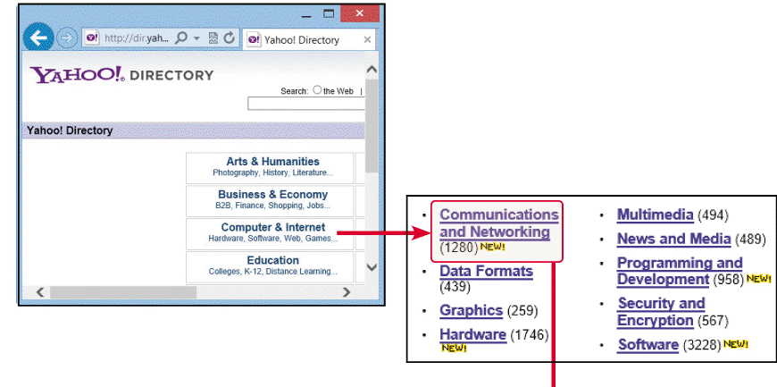
Subject Directories
A subject directory Example
Subject directories organize information into various categories and provide an overall framework for finding information
FIGURE TK D-7 Using a search directory is quite different from using a search engine, and can be faster
and more efficient. In the example shown, the user visited the Yahoo! Directory, clicked the Computer &
Internet category, and then selected the Communications and Networking topic. Next, the user requested a
list of magazines, which are displayed in the last panel (Continues)

Slide 20
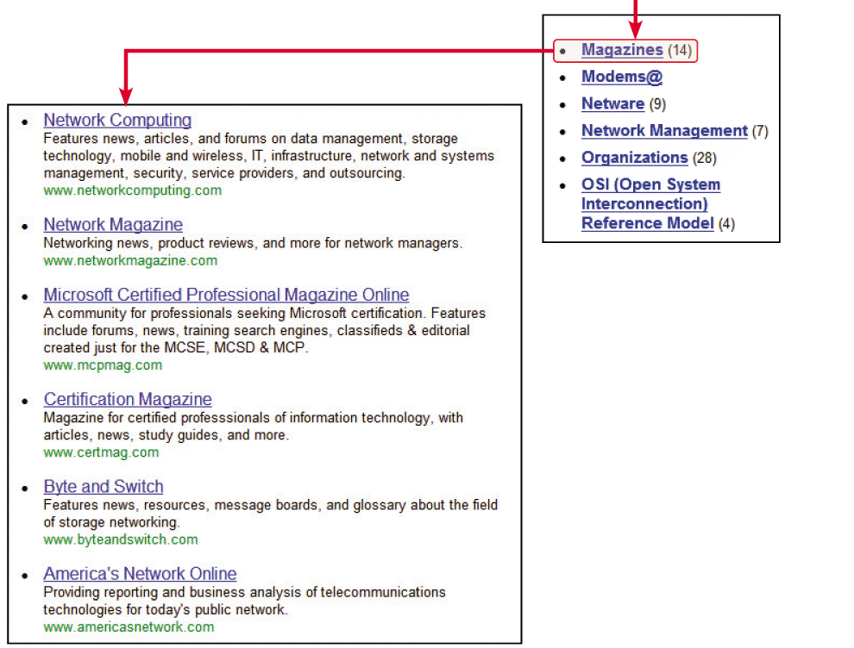
Subject Directories (Cont.)
FIGURE TK D-7 Using a search directory is quite different from using a search engine, and can be faster and more efficient. In the example shown, the user visited the Yahoo! Directory, clicked the Computer & Internet category, and then selected the Communications and Networking topic. Next, the user requested a list of magazines, which are displayed in the last panel

Slide 21
Search Engines (Cont.)
Advantages and Disadvantages of Subject Directories
Main advantage of a subject directory is that it provides an overview when you are not sure of the size and scope of your topic
Disadvantages include
Relying on subjective decisions that might affect the quality of search results
Some subject directories are updated continually; others might not be current
Forces you to work your way through a series of levels, rather than using specific words and phrases to locate directly the material you seek

Slide 22
The Invisible Web
Refers to Web sites that are indexed by the major search engines and are publicly accessible
Invisible Web Examples
Specialized topic databases
Hardware and software vendors
Publications: databases of published and archived articles
Libraries: searchable catalogs for thousands of libraries
Government databases: (census data, statutes, patents, copyrights, and trademarks
Auction sites: listings of items, bidders, and sellers
Locators: telephone numbers, addresses, and e-mails
Career opportunities: job listings and résumé postings

Slide 23
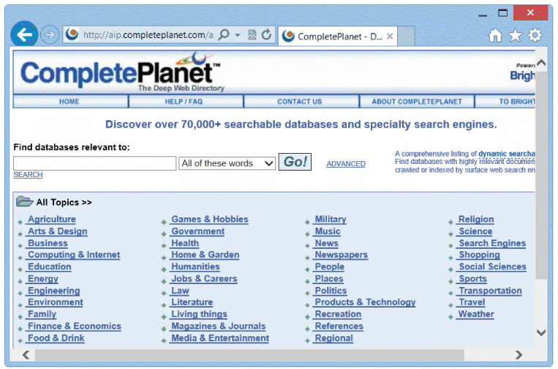
The Invisible Web (Cont.)
FIGURE TK D-8 The CompletePlanet site is organized by topics, and has links to many searchable databases whose contents cannot be indexed by traditional search engines

Slide 24
The Invisible Web (Cont.)
Navigation Tools for the Invisible Web
You can access the invisible Web in several ways
One approach is to use a search engine to locate a portal, or entrance, to a searchable database by including the word, database, as a required search term
Another approach uses specialized portals that list and organize searchable databases

Slide 25
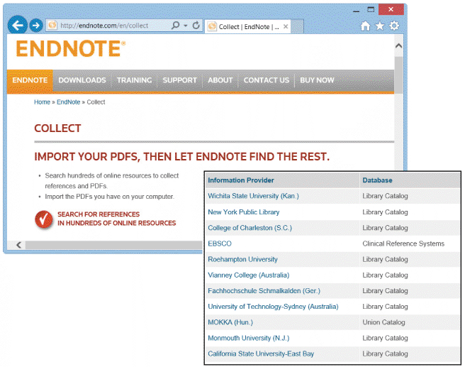
The Invisible Web (Cont.)
FIGURE TK D-9 Many researchers use Endnote, which allows you to connect
directly to hundreds of government and university databases. The inset panel shows a small sample of the available sites and resources

Slide 26
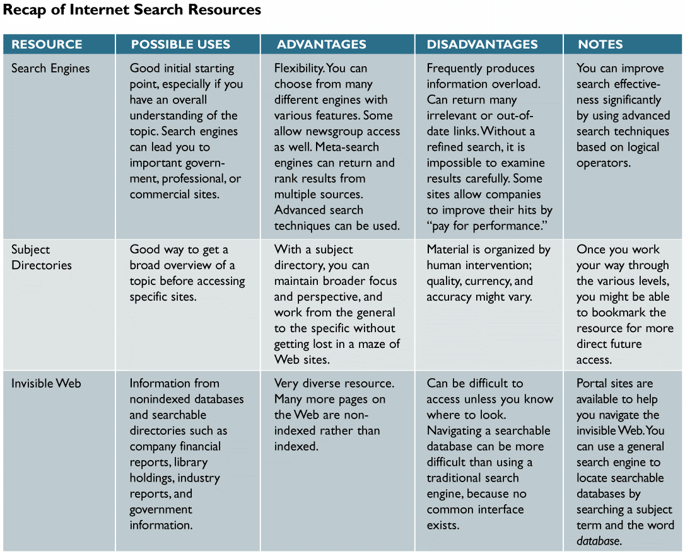
The Invisible Web (Cont.)
FIGURE TK D-10 A recap of the three main Internet search resources: search engines, subject directories, and the invisible Web. Notice that each option has advantages and disadvantages

Slide 27
Internet Communication Channels
Social Networking
Sites such as Facebook, Twitter, and LinkedIn have gained enormous popularity in recent years
Many people use these communication channels along with more traditional choices, such as e-mail, blogs, chat rooms, and instant messaging
As a systems analyst, social networking allows you to connect to an extended family of personal and professional contacts, with unlimited opportunities
Forums
Most people are familiar with bulletin boards they see at school, at work, and in their communities. Using thumbtacks or tape, people post information and read what others have posted

Slide 28
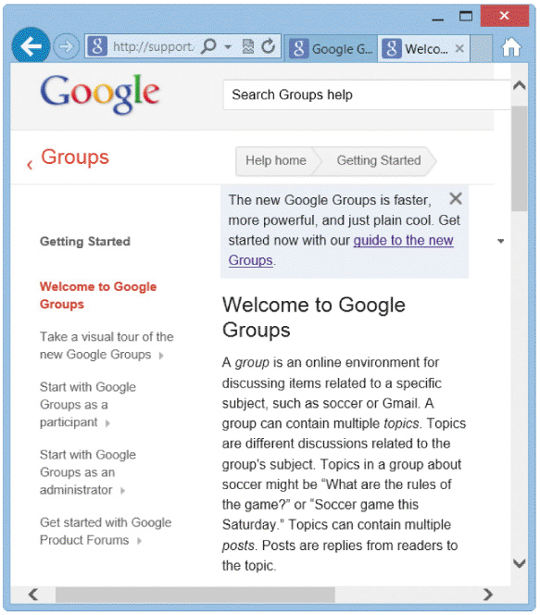
Internet Communication Channels (Cont.)
FIGURE TK D-11 Google Groups allows you to participate in
numerous discussion groups on every imaginable topic, and to create new
groups

Slide 29
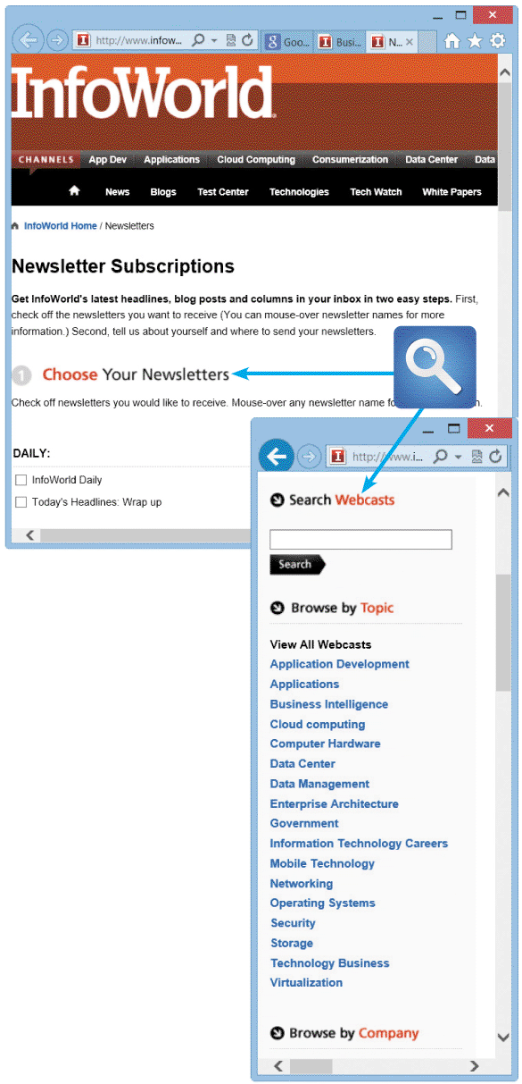
Internet Communication Channels (Cont.)
Newsletters, Blogs, Podcasts, and Webcasts
Newsletters are a convenient way to keep current on topics of interest
Many online magazines and other groups offer free e-mail newsletters to subscribers interested in specific topics
FIGURE TK D-12 InfoWorld offers free newsletters, Webcasts, and other valuable online resources

Slide 30
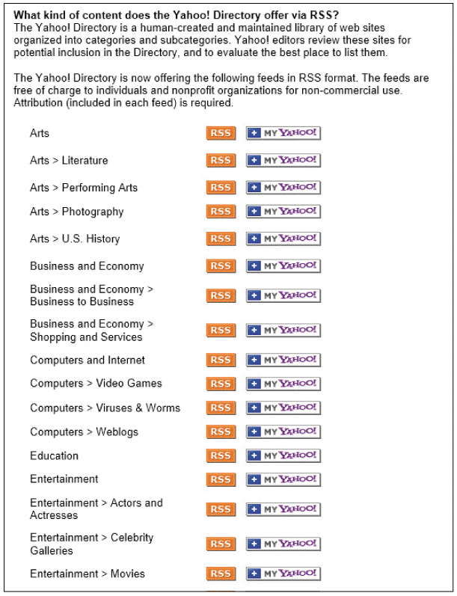
Internet Communication Channels (Cont.)
Webinars
An Internet-based training session that provides an interactive experience
Mailing Lists
Also called a listserv, is similar to a newsgroup
Provides a forum for people who want to exchange information about specific topics
FIGURE TK D-13 Yahoo! uses RSS feeds to publish news about a wide variety of topics, some of which are shown here. The Yahoo! site also allows you to create a customized feed by entering a search term or phrase

Slide 31
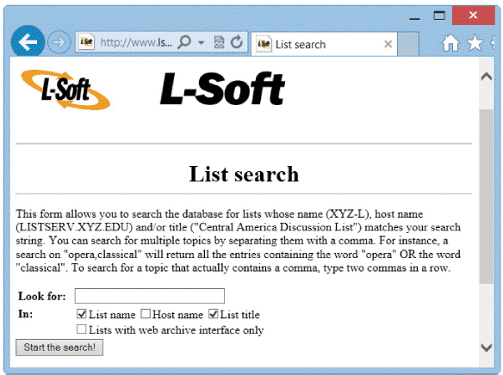
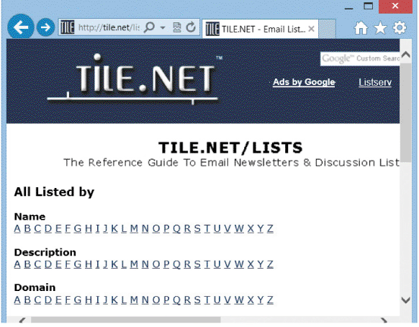
Internet Communication Channels (Cont.)
FIGURE TK D-14 Lsoft.com and tile.net are examples of Web sites that organize mailing lists by name and subject

Slide 32
Internet Communication Channels (Cont.)
Web-Based Discussion Groups
Another online communication resource is called a Web-based discussion group
An online community that combines features of mailing lists and forums
Web-based discussion groups can be accessed through portals, such as Yahoo! or Google, or by visiting vendor sites, such as Cisco, IBM, or Apple

Slide 33
Internet Communication Channels (Cont.)
Chat Rooms
Also called a channel, is an online meeting place where users can interact and converse in real time
Instant Messaging and Text Messaging
Instant messaging (IM) allows online users to exchange messages immediately, even while they are working in another program or application

Slide 34
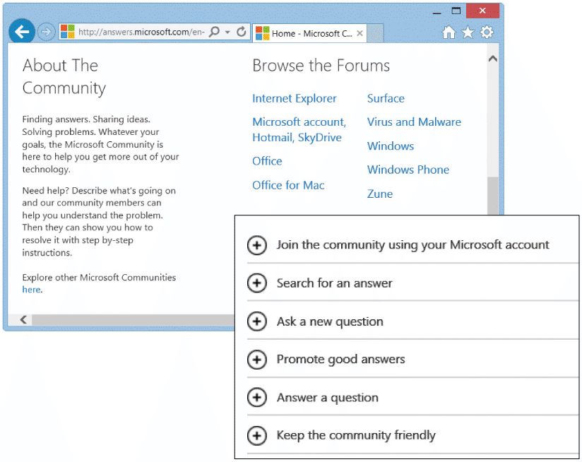
Internet Communication Channels (Cont.)
FIGURE TK D-15 The Microsoft Community site offers technical forums, searchable knowledge bases, and an opportunity to meet, interact, and share your views with
colleagues and people with similar interests

Slide 35
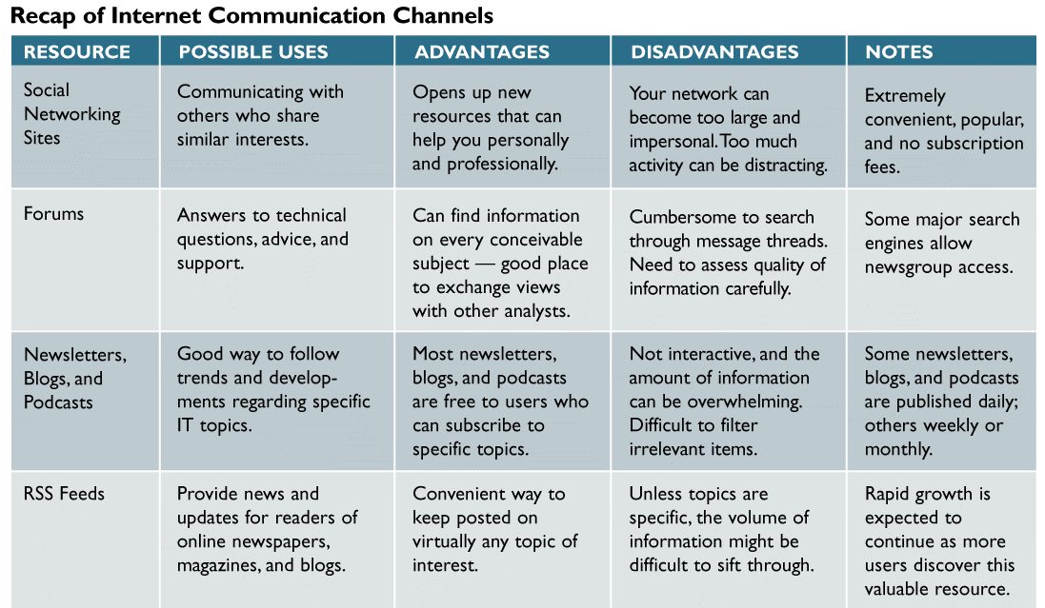
Internet Communication Channels (Cont.)
FIGURE TK D-16 A recap of Internet communication channels that can assist a systems analyst in online research and communication. Notice that each option has advantages and disadvantages (Continues)

Slide 36
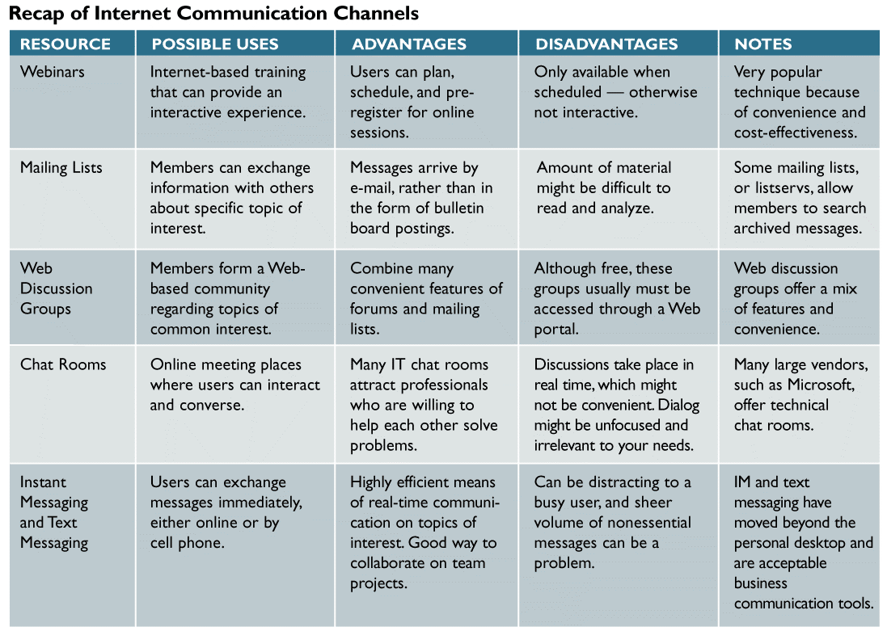
Internet Communication Channels (Cont.)
FIGURE TK D-16 A recap of Internet communication channels that can assist a systems analyst in online research and communication. Notice that each option has advantages and disadvantages

Slide 37
Information Technology Community
The IT community includes numerous publications and online magazines, searchable databases, Web-based discussion groups, and mailing lists
Four important components of the IT community are corporate resources, government resources, professional resources, and online learning resources
Corporate Resources
Corporate resources can provide general IT knowledge and background, as well as help solve specific business challenges

Slide 38
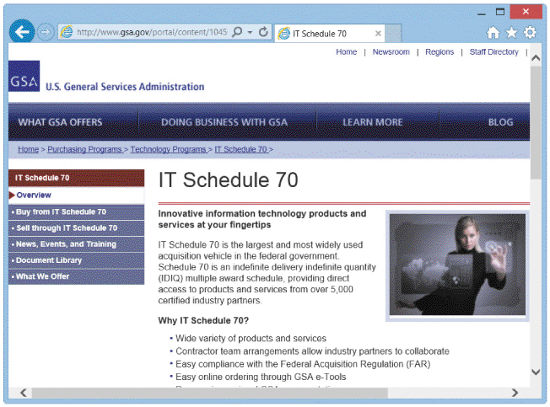
Information Technology Community (Cont.)
Government Resources
The IT needs of the federal government are enormous
Excellent federal IT resources exist
Comprehensive, nonbiased information for IT professionals
FIGURE TK D-17 The GSA site contains information about federal IT policies, news, and related links. The screen shows a sample from the IT Regulations, Guidelines, and Laws section

Slide 39
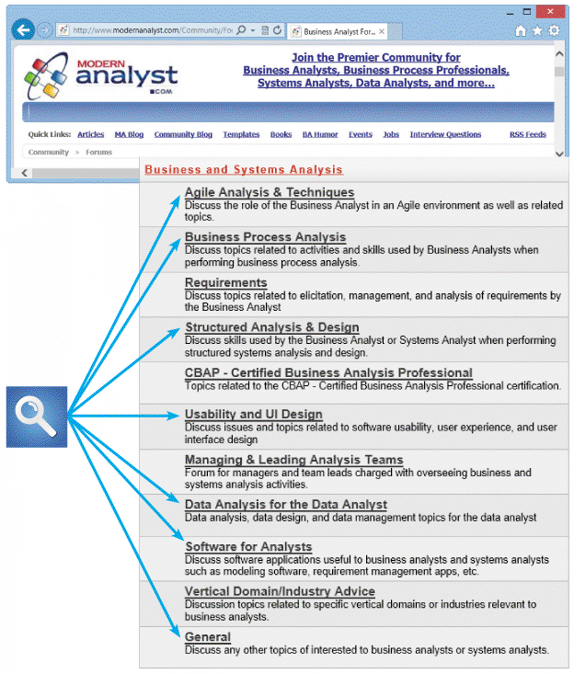
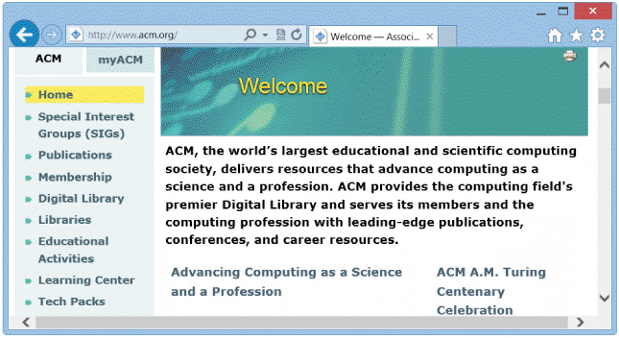
Information Technology Community (Cont.)
FIGURE TK D-18 The ACM site is one of many resources that a systems analyst can use to keep up with current issues, trends, and opportunities
FIGURE TK D-19 Students should explore the Modern Analyst site, which includes forums about many topics covered in this textbook. This would be a 9ood place to connect with others and share information

Slide 40
Information Technology Community (Cont.)
Online Learning Resources
Also called e-learning, is a term that refers to the delivery of educational or training content over the public Internet or an intranet
BENEFITS OF ONLINE LEARNING
Convenient. You can participate in training when and where you want
Economical. Online learning options generally are less expensive than traditional face-to-face learning
Customizable. Generally, you can tailor the learning experience to your interests
and needs

Slide 41
Information Technology Community (Cont.)
DISADVANTAGES OF ONLINE LEARNING
Interaction - Can be highly collaborative, but lacks the face-to-face component that some learners find necessary
Less likely to receive the focused feedback that you would get when participating in traditional classroom training
Interface - Might experience slower processing performance, especially with video, audio, or high-resolution graphics
Suitability - Might not be the best option, particularly if the content is complicated and unfamiliar to you

Slide 42
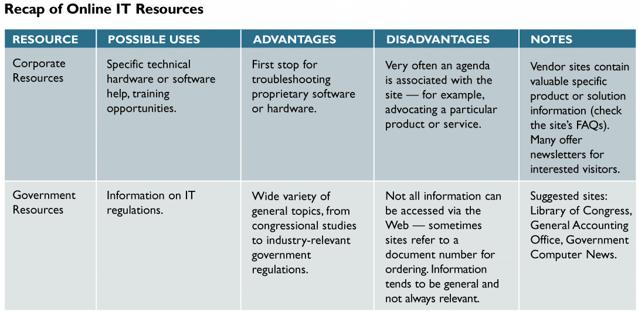
Information Technology Community (Cont.)
FIGURE TK D-20 A recap of online resources that a systems analyst can use to keep up with current issues and trends in IT. Notice that each option has advantages and disadvantages (Continues)

Slide 43
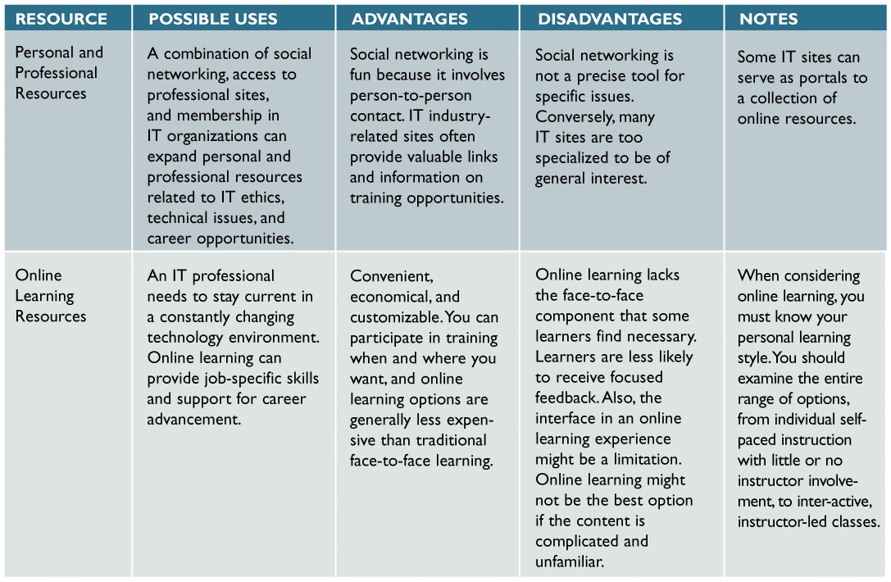
Information Technology Community (Cont.)
FIGURE TK D-20 A recap of online resources that a systems analyst can use to keep up with current issues and trends in IT. Notice that each option has advantages and disadvantages

Slide 44
Toolkit Summary
The Internet is a worldwide network that integrates many thousands of other networks, which in turn link millions of government, business, educational, and personal users around the globe
The Internet allows access to the World Wide Web, usually called the Web, which refers to the global collection of electronic documents stored on the Internet
An Internet research strategy should use a four-step approach: review your information requirements, use the proper search tools and techniques, evaluate the results, and consider copyright and data integrity issues

Slide 45
Chapter Summary (Cont.)
The primary research tools include search engines, subject directories, and a collection of searchable database resources called the invisible Web
A subject directory is a Web site that allows you to access topics by using a hierarchy, starting with general headings and proceeding to more specific topics
The invisible Web, or hidden Web, describes numerous text, graphics, and data files stored in collections that are unreachable by search engines

Slide 46
Chapter Summary (Cont.)
Many analysts use social networking as a primary online tool to expand personal and professional contacts and communication
When an IT professional needs to research a topic or seek background information, he or she can turn to an assortment of sites and resources called the information technology (IT) community
Professional development through online learning is a way for IT workers to remain current in their chosen areas

